Slide 1
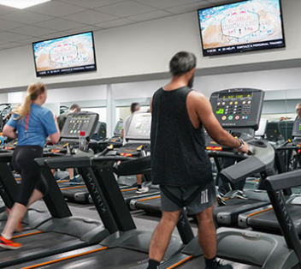
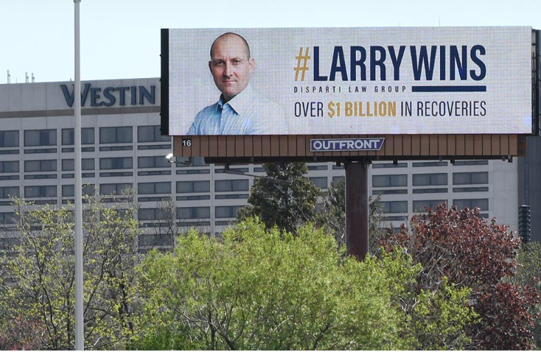
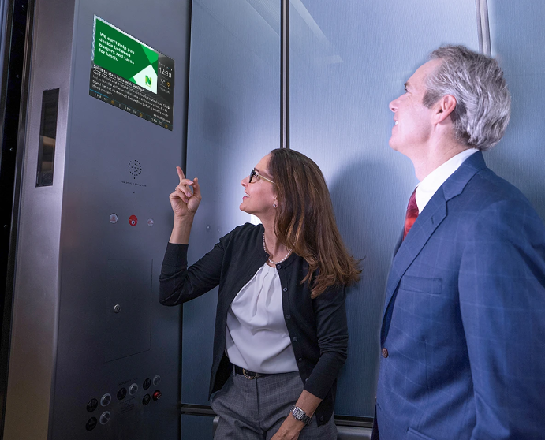








NEARBY ADVERTISING OPPORTUNITIES ON OUT OF HOME SCREENS: BILLBOARDS, RESTAURANTS, BARS, STORES, GAS PUMPS AND MORE
You can now catch the eye of nearby customers across multiple out of home screens with a single buy! It’s easy- simply provide a list of zip codes where you would like to appear, and we’ll provide you with a list of available screens. Then just choose one or all, choose a package below, provide your creative file (or let us produce one for you) and we’ll get you out there!
PLATINUM: 25,000 monthly impressions $x/month
GOLD: 10,000 monthly impressions $x/month
SILVER: 5,000 monthly impressions $x/month
VIDEO BILLBOARDS • VIDEO SIGNS • RESTAURANTS • BARS • MALLS STORES • SALONS • TRANSIT STATIONS • TAXIS/UBERS • GAS STATIONS GYMS • CONVENIENCE STORES • OFFICES • ELEVATORS • WAITING ROOMS ALL FROM THE LEADERS IN OUTDOOR ADVERTISING:
Let’s get started today!

